Slide 1
Closure Polynomials for
Strips of Tetrahedra
Federico Thomas and Josep M. Porta

Slide 2
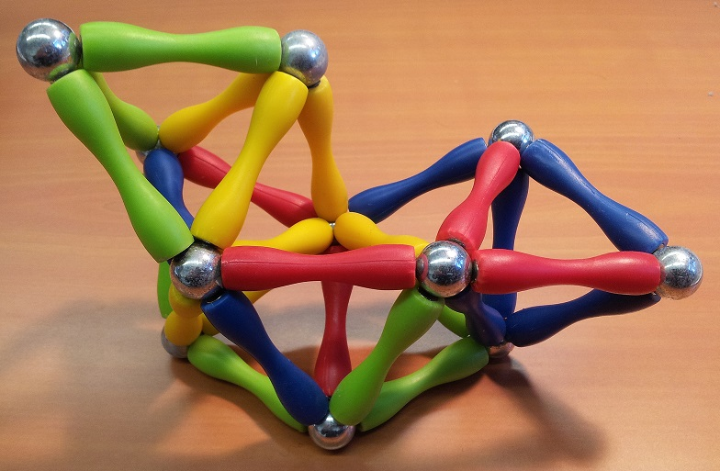
What’s a strip of tetrahedra?

Slide 3
If shared traingular face degeneres, the structure flexes …

Slide 4
What’s the problem to solve?
Problem: Find of possible assembly modes
We remove one edge
We do not impose the
orientations of the tetrahedra
We impose the distance between the endpoints

Slide 5
Outline of the presentation
A substitution rule to derive a scalar closure condition
Deriving a closure polynomial
Examples
  Forward kinematics of the decoupled platform
  Forward kinematics of a 4-4 Gough-Stewart platform

Slide 6
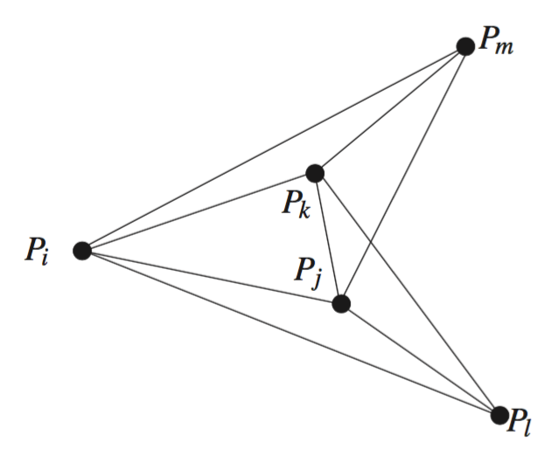
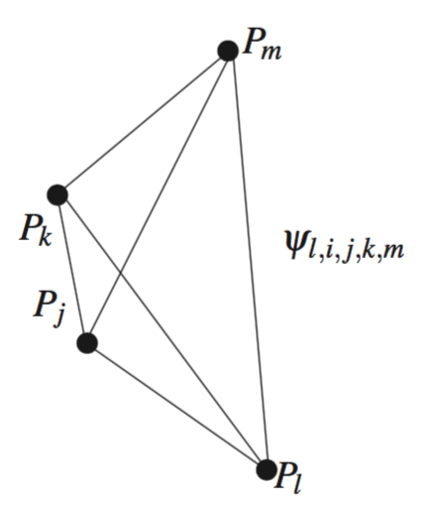

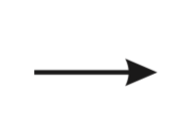
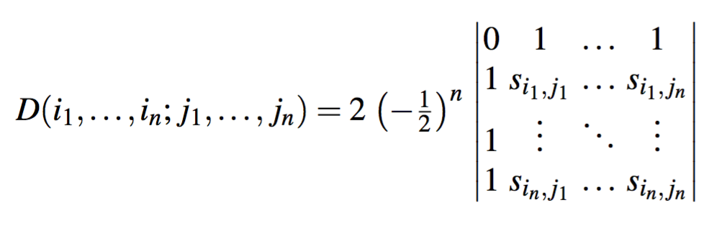
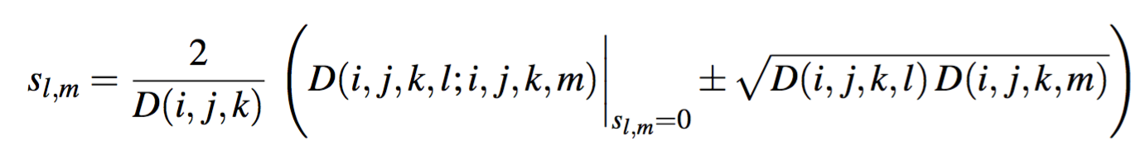
A substitution rule

Slide 7
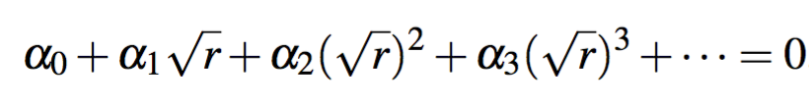
Clearing radicals
After iteratively applying this substitution rule, we end up with a closure condition containing nested radicals.

Slide 8
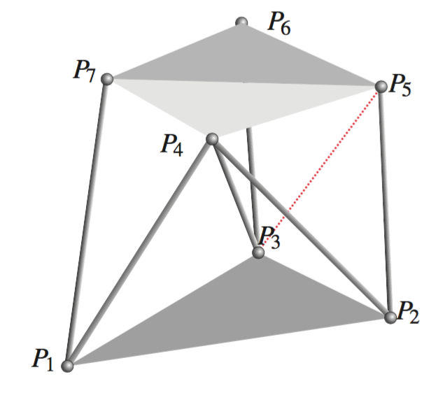
Example 1: The forward kinematics of the decoupled platform

Slide 9
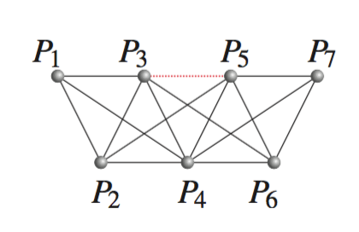
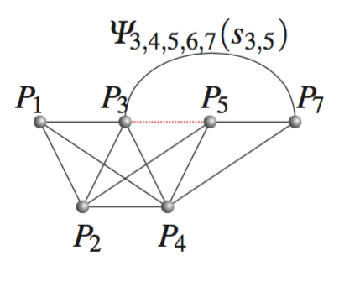
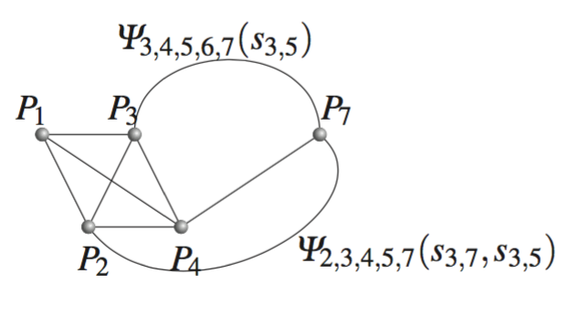
Example 1: The forward kinematics of the decoupled platform

Slide 10
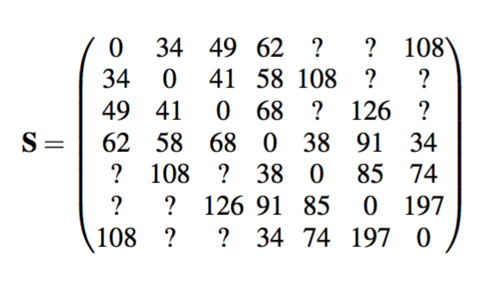
Example 1: The forward kinematics of the decoupled platform

Slide 11
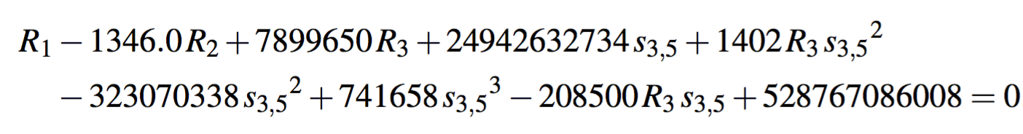
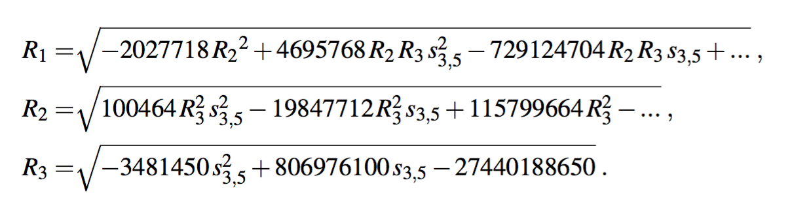
Example 1: The forward kinematics of the decoupled platform

Slide 12

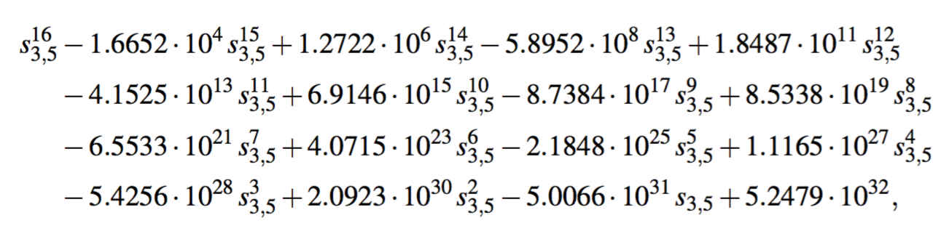
Example 1: The forward kinematics of the decoupled platform
After clearing radicals, we obtain a polynomial of 24th degree, but we know that it should be of degree 16 to be minimal.
The rod connecting P3 and P5 belongs to the shared face defined by P3, P4, and P5 which is singular when D(3,4,5)=0, that is, when
After dividing the obtained polynonimial by this factor till the remainder is not null, we get

Slide 13
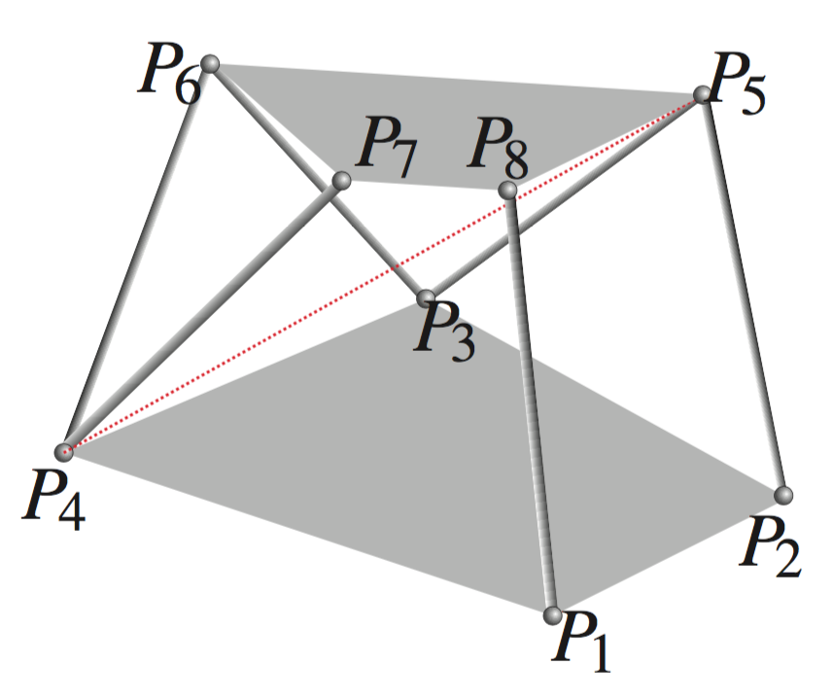
Example 2: The forward kinematics of a 4-4 platform
Coplanar base and platform
24 solutions (12+12)

Slide 14
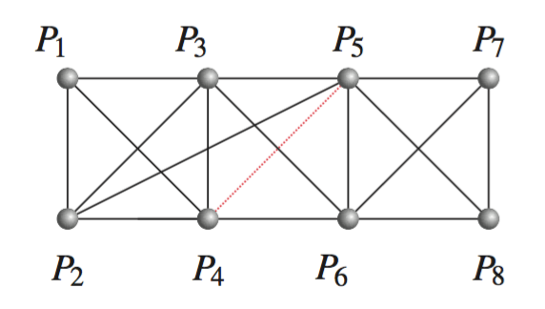
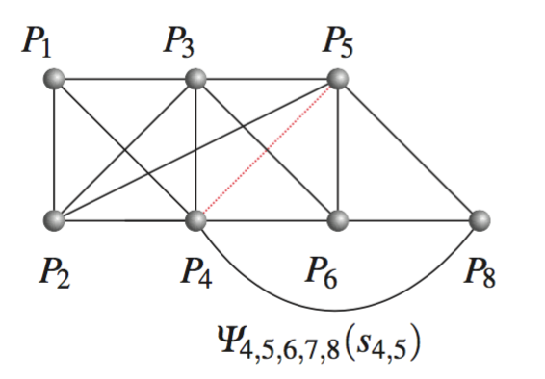
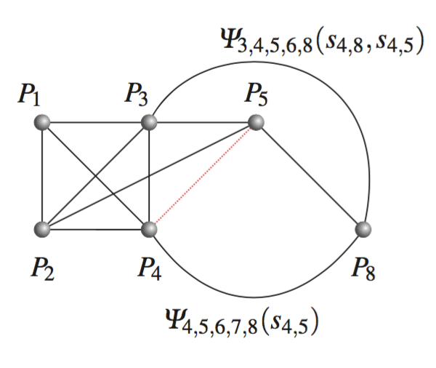
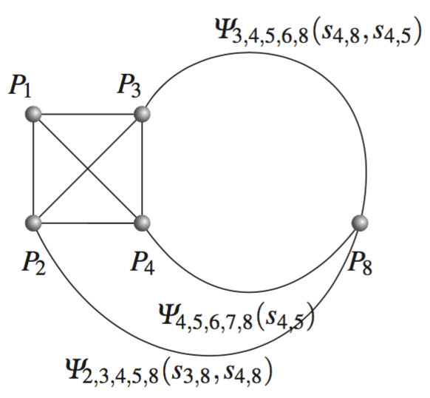

Slide 15
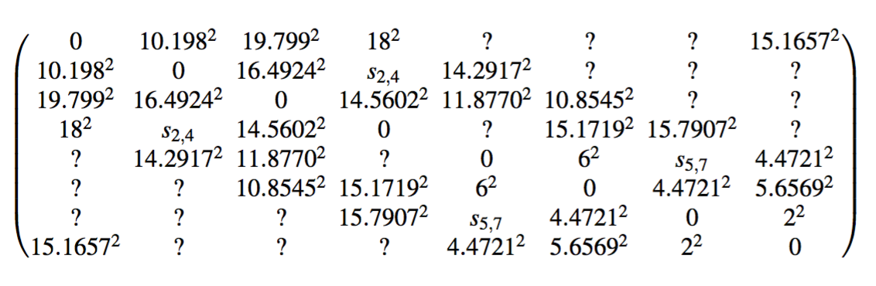
Numerical Example

Slide 16



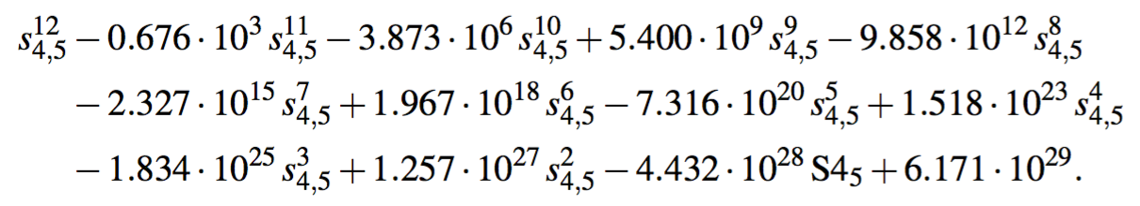
Numerical Example
After clearing radicals, a 52nd- degree polynomial in is obtained, but we know that it should be of degree 12.
The rod connecting P4 and P5 belongs to two shared faces (the ones defined by P4P5P6 and P3P4P5), whose associated singular terms are
After iteratively dividing the obtained polynomia lby these two terms till the remainder is not null, we get

Slide 17
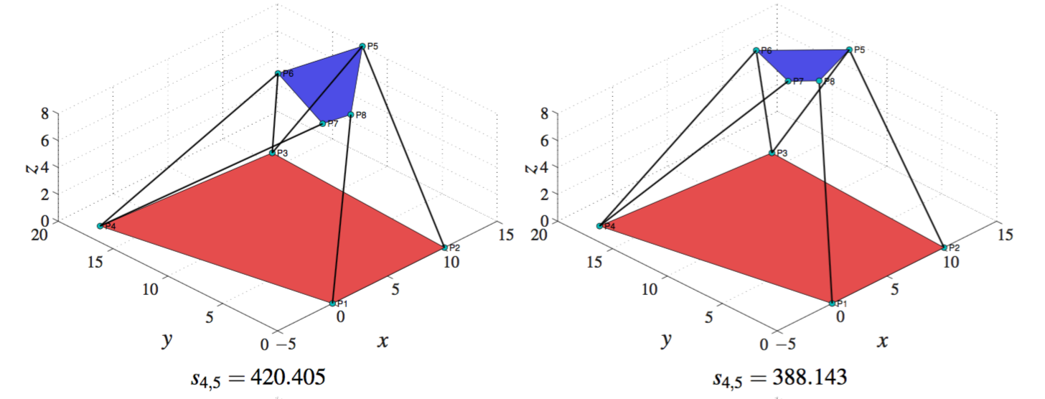
Numerical Example

Slide 18
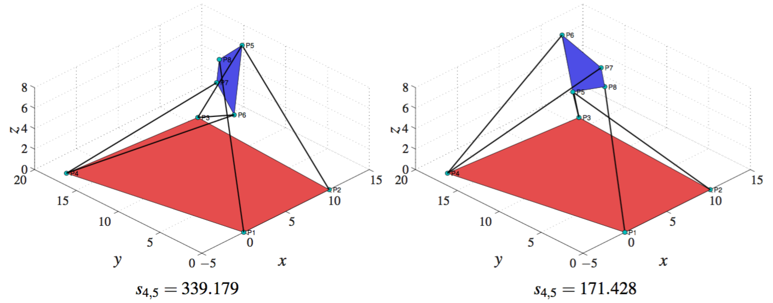
Numerical Example

Slide 19
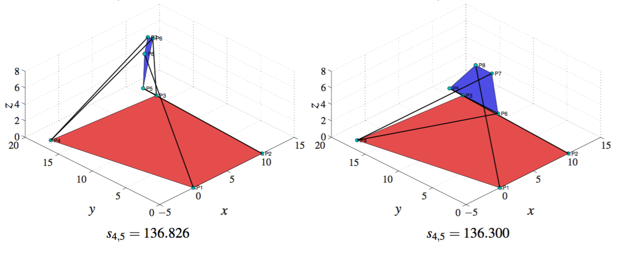
Numerical Example

Slide 20
Conclusions
The presented technique requires some symbolic manipulations. Despite this, it runs faster than all global root finders.
J.M. Porta and F. Thomas, "Closed-Form Position Analysis of Variable Geometry Trusses”, submitted for publication
This technique can be extended to:
                - multiple strips of tetrahedra, and
                - include orientation constraints

