Slide 1
0. Overview and background
Designing the “perfect” assistant
Robot appearance and emotion
Robots in the workplace
Robots in education
Human-robot interaction and human dignity
Social responsibility and robot morality
Bibliography and initiatives to follow up

Slide 2
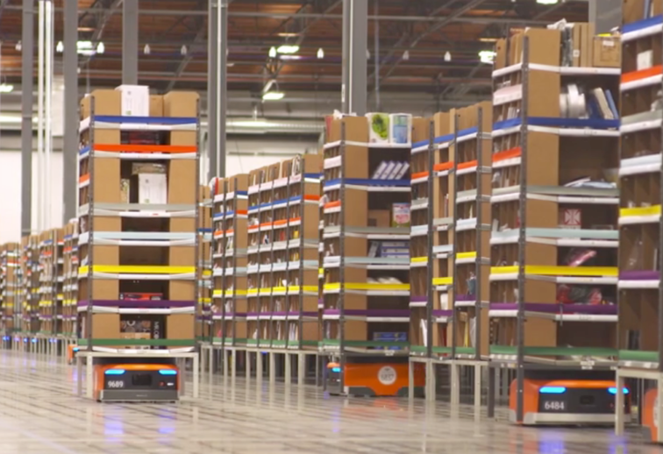
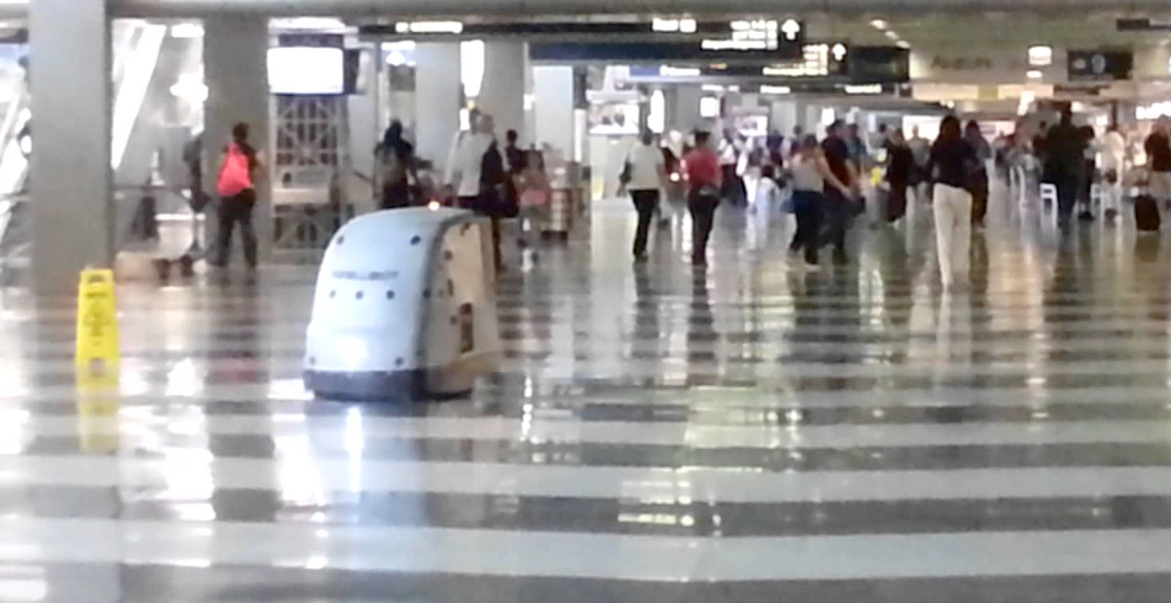
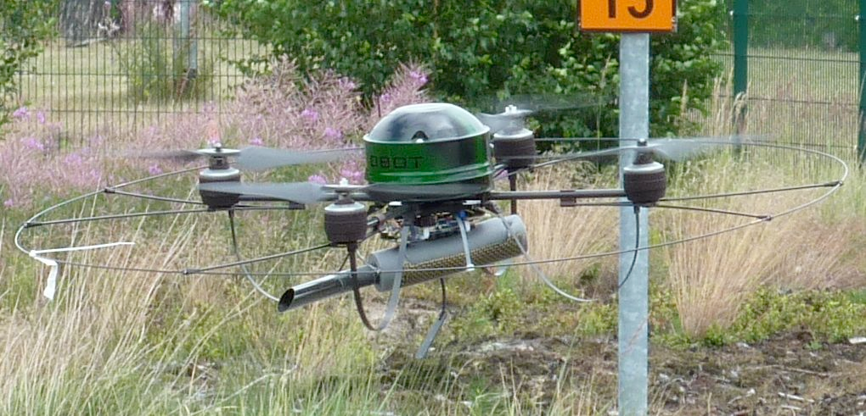
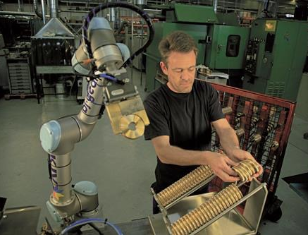
0.1. Motivation: Rise of service and collaborative robots

Slide 3
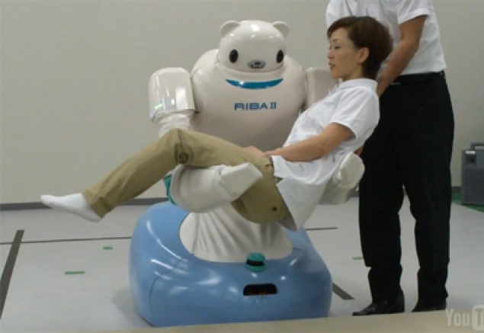
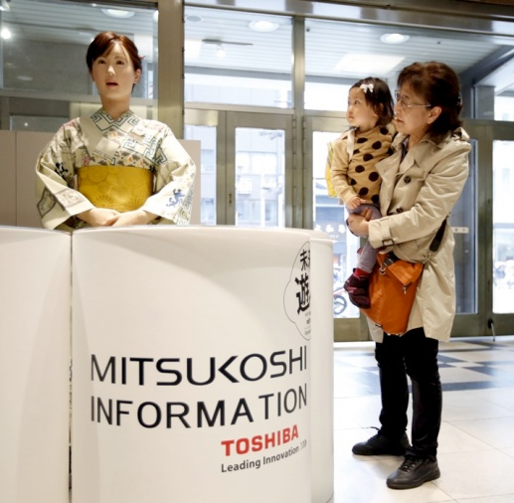
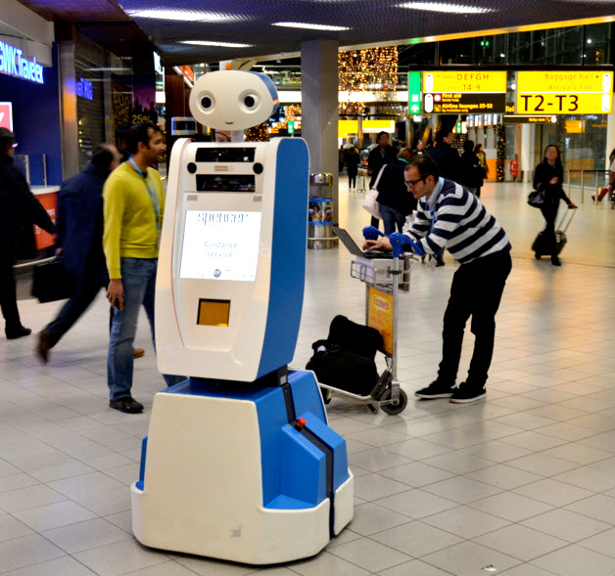
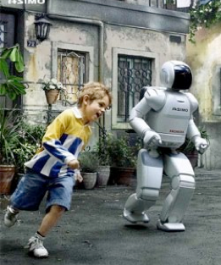
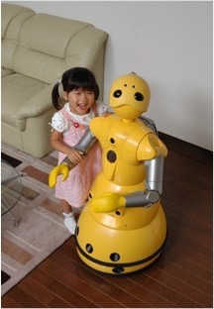
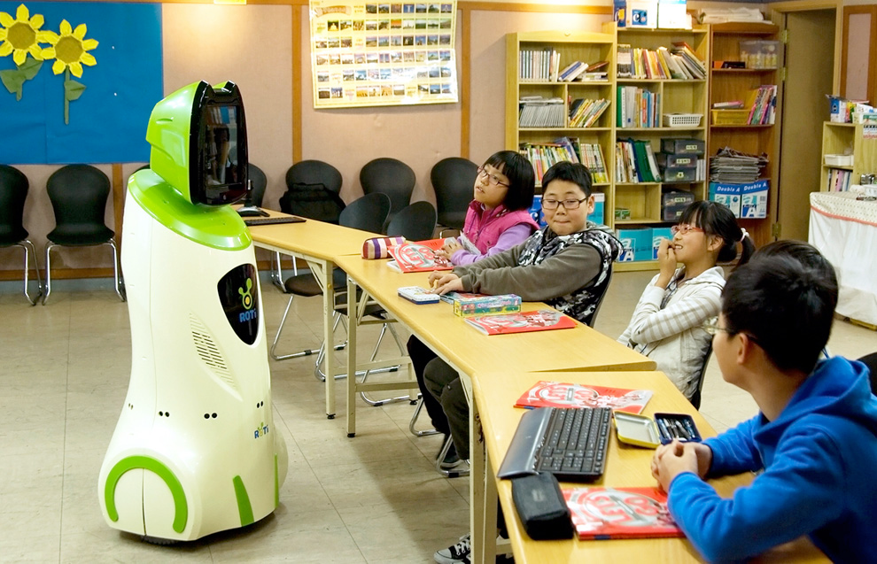
0.1. Motivation: Robots enter social contexts

Slide 4
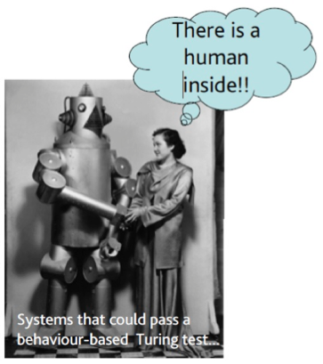
0.1. Motivation: Need for an Ethics Debate
Service and assistive robots raise new issues in entering the domain of human decision-making, feelings, and relationships.
Robots and humans… two types of ties:
Artificial retinas, sensorized dresses, exoskeletons, telepresence… robotic prostheses expand our body and increase our autonomy.
Living with butlers and artificial nannies, learning from robotic teachers, sharing work and leisure with humanoids… will enhance our intellectual and social habits? will develop new ones?

Slide 5
0.1. Motivation: Can technological evolution be predicted?
Methodological difficulties:
Appearance of unforeseen uses for devices (Ihde, 2004)
Limitations of language to describe the future: “it is through technique that we perceive the sea as navigable” (Heidegger)
Cannot be studied separately from the socio-cultural context: Social construction of reality (Berger and Luckmann, 1966)
[Ballesté and Torras 2013]

Slide 6
Anticipate possible future scenarios
0.1. Motivation: Role of Science Fiction (SF)
“What SF stories can do better than almost anything else is to provide not just an idea for some specific technical innovation, but also to supply a coherent picture of that innovation being integrated into a society, into an economy, and into people’s lives.”
[Neal Stephenson: “Innovation starvation”, 2011]

Slide 7
Anticipate possible future scenarios
0.1. Motivation: Basing an Ethics course on an SF novel
“It is the relationships that we have constructed which in turn shape us”
[Robert C. Solomon, “The Passions”, 1977]

Slide 8
0.2. Preliminaries on Roboethics
Roboethics is the subfield of applied ethics studying both the positive and negative implications of robotics for individuals and society, with a view to inspire the moral design, development and use of so-called intelligent/autonomous robots, and help prevent their misuse against humankind.
[Veruggio et al. 2011]
Three aspects:
Human ethics applied to robotics
Codes of ethics embedded in the robots themselves (“machine ethics”)
Ethics that would emerge from a potential future consciousness of robots

Slide 9
0.2. Preliminaries on Roboethics
Issues shared with information and communication technologies:
incidence on the job market
legal liability
privacy
safety and reliability
vulnerable groups and digital divides
…
Robots can be thought of as the interface of the digital world with the physical world, and therefore they carry issues previously restrained to digital information to the reality of physical objects and environments.
[Nourbakhsh 2013]

Slide 10
0.2. Ethical theories relevant to robotics
Utilitarianism or Consequentialism — maximizing the number of people that enjoy the highest beneficial outcomes
Deontologism — acting only according to maxims that could become universal laws
Virtue ethics — relying on the moral character of virtuous individuals
Social justice — all human beings deserve to be treated equally and there must be a firm justification in case of mistreatment
Common goods — living in a community places constraints on the individual
Religious ethics — norms come from a spiritual authority
Information ethics — policies and codes for governing the creation, organization, dissemination, and use of information
[Sullins 2015]

Slide 11
0.2. Ethical theories relevant to robotics: Hybrid ethics
Since no single theory is appropriate for addressing all ethical issues arising in the design and use of robots, we take a pragmatic option:
Hybrid ethics combines:
Top-down theories — those applying rational principles to derive norms, and
Bottom-up theories — those inferring general guidelines from specific situations.
In what follows, we will acknowledge and apply the ethics theories that seem more suited to each particular case.
[Wallach and Allen 2018]

Slide 12
0. Overview and background
Designing the “perfect” assistant
Robot appearance and emotion
Robots in the workplace
Robots in education
Human-robot interaction and human dignity
Social responsibility and robot morality
Bibliography and initiatives to follow up

Slide 13
1. Designing the “perfect” assistant
Chapter 1 - Dr. Craft
… A good choice of stimuli, that’s the secret to wellbeing. [..] we can’t change man or turn his brain upside down, we can’t modify even the smallest reaction. The only option is to control his surroundings, control what he feels through the stimuli he receives. A key idea, but when he presented it as the leitmotif of the new line of robots, no one gave it a bit’s worth of notice. Too simple, they said. How short-sighted! [..] they couldn’t tailor-make a ROB for everyone; they had to come up with a generic ROB that was highly adaptable and, most important of all, one that could achieve a very fast adaptation. If it took one week for a ROB to work out how to wake up its PROP or how much sugar to put in his coffee, the whole idea would go down the drain.
What he wants is a creativity prosthesis. Or an assistant, it doesn’t matter; something that would stimulate him to think differently, that would warn him when he started down well-worn paths and would show him the promising forks in the road, those susceptible to innovation.

Slide 14
Designing the “perfect” assistant
Debate stemming from Chapters 1 and 5 in the novel
The traits attributed to a “perfect” assistant vary largely among cultures, types of users, and individual viewpoints. From his entrepreneurial stand, Doctor Craft argues for highly-adaptable robots that would fit their owners like a glove, covering all of their needs and maintaining them in a permanent state of wellbeing, but as a user he requests a hypothetical assistant to stimulate his thinking and to inspire him to behave differently than usual. Similarly, Leo adheres to more strict criteria (e.g., as regards to safety and maintenance) in his professional design activity than when he tunes his robot as a user.
Robot communication and action can be perceived as overly intrusive and annoying. Doctor Craft roars to his robot Alpha+: «Get off me, you confounded beast» and gives it a shove as it is trying to wake him up. Thus, reaction to robotic assistance depend a lot on the user and the circumstances, which has to be carefully taken into account at design time.

Slide 15
Designing the “perfect” assistant
1.2. Ethical background and discussion
Virtues attributed to the Victorian lady’s companion:
able to distinguish its owner from other people, animals and things
able to recognize its owner’s emotions and intentions
behaving in a predictable and dependable way
protective and supportive of the user in the handling of information and communication with other people
polite but firm in the owner’s interest
having a model of its own capabilities
operationally reliable and requiring neither much effort from the owner to use nor special maintenance
[Peltu and Wilks 2008]

Slide 16
Designing the “perfect” assistant
1.2. Ethical background and discussion
Some design considerations:
implementation of safeguards to ensure robots augment human experiences rather than increase social barriers
designing robots to be intentionally machine-like, since humans view robots as agents and react to them socially
transparency — conveying the intention of robot behavior to the surrounding people through gestures, voice or context
(Remark to 2n and 3rd: humanlike communication is largely prioritized by people over humanlike behavior and appearance [Dautenhahn et al. 2005])
real-time status indicators are suggested to increase trustworthiness, and kill switches could enhance users’ perception of safety
avoid deception
[Knight 2014]
[van der Loos 2007]
[Riek and Howard 2014]

Slide 17
Designing the “perfect” assistant
1.2. Ethical background and discussion
South Korea Robot Ethics Charter:
limit robot autonomy by making it always possible for a human to assume control
guarantee user and community safety
minimize the users’ risk of any psychological harm such as antisocial or sociopathic behaviors, depression or anxiety, stress, and addictions
clearly identify the product and protect it from alteration
protect personal data
ensure that robot actions are traceable at all times
make designs ecologically sensitive and sustainable

Slide 18
Designing the “perfect” assistant
1.2. Questions
1.A - Should public trust and confidence in robots be enforced? If so, how?
1.B - Is it admissible that robots be designed to generate addiction?
1.C - Should the possibility of deception be actively excluded at design time?
1.D - Could robots be used to control people?

Slide 19
Designing the “perfect” assistant
1.A - Should public trust and confidence in robots be enforced? If so, how?
Eurobarometer 427 (2015): while personal experience with robots is rising, the proportion of respondents expressing a positive view has declined since 2012, from 70% down to 64%.
Roboticists should:
take responsibility for their public image (e.g., commit to correct any outrageous claims in the press).
employ a language that provides the public with the knowledge they need to elucidate their legitimate concerns (e.g., safety, undesired side effects), while avoiding recourse to value hierarchy and semantic inflation.
make clear the short-term and long-term implications of any research result.
[Principles of Robotics 2010]
[Nourbakhsh 2010]

Slide 20
Designing the “perfect” assistant
1.B - Is it admissible that robots be designed to generate addiction?
Addiction to robots could be more dangerous and disrupting than to TV, internet, and videogames, because robots can cover a much wider range of areas in our daily life than other technologies.
The question of where the boundary lies between comforting exercises and addiction to robots in elderly groups often arises.
Technology is designed to be addictive, otherwise companies would not make money. 78% of adults in the United States regard themselves as nomophobic.
How can robot designers cope with the sometimes opposite interests of companies and users? Some argue that business competition and public education would result in products satisfying them both.
[Veruggio 2005]
[Espingardeiro 2015]
[Oliver 2015]
[Roberts 2005]

Slide 21
Designing the “perfect” assistant
1.C - Should the possibility of deception be actively excluded at design time?
Deception may take many forms:
elderly people may be deceived into believing that their robot assistants care about them,
children may have the induced illusion that robot toys have mental states and emotions,
the general public may be deluded to think that robots are truly intelligent and have intentions.
«give hearing and voice to a robot and people expect it to be intelligent»
Robots should not be designed in a deceptive way to exploit vulnerable users; instead their machine nature should be transparent.
[Matthias 2005]
[Breazeal 2005]
[Principles of Robotics 2010]

Slide 22
Designing the “perfect” assistant
1.D - Could robots be used to control people?
Not only robot assistants may share personal material without the user knowing, but information may flow the other way too… «the watching eye and punitive hand of the state»
Robots may enforce certain habits and values on the user, the key questions being who decides which these should be and whom they would benefit: the user (e.g., follow a diet), society at large (e.g., promote healthy habits), or a particular group of people (e.g., reduce medical expenditure).
Three “nudging” degrees: weak paternalism (opt in), libertarian paternalism (opt out), and strong paternalism (no way out).
Is nudging to enforce social justice (for instance) ethically appropriate?
[Lowe 2010]
[Borenstein and Arkin 2016]

Slide 23
0. Overview and background
Designing the “perfect” assistant
Robot appearance and emotion
Robots in the workplace
Robots in education
Human-robot interaction and human dignity
Social responsibility and robot morality
Bibliography and initiatives to follow up

Slide 24
2. Robot appearance and emotion
Chapters 9/12 - Celia
Lu [adoptive mother] gave me [Celia] my very own robot just for me. [..] it has a kind of head with no nose, mouth or ears, it just has two cameras, and a screen embedded in its chest. It’s called ROBbie.
[..] Celia stops for a moment, touched by the words, and looks for his eyes: no friend had ever sworn their loyalty so convincingly, but two black holes bring her back down to earth. Though not entirely. As they start moving again, she watches the robot out of the corner of her eye and it pleases her to see his dignified posture, gently swinging his strong, shiny arms. It feels good to walk along beside him, she feels protected, she can trust him. What does it matter that he doesn’t have eyes, people don’t look at each other anymore anyway.”
[Leo] is not sure what drew him to this realistic mechanical baby. [..] What woman could resist the charm of a baby that smiles when she coos at it, that she can cuddle at will while watching her favorite program, that recognizes her voice and crawls along behind her, flattering her with sweet noises?

Slide 25
Robot appearance and emotion
Debate stemming from Chapters 9, 10 and 12 in the novel
Appearance strongly influences people’s attitude towards robots: the more anthropomorphic the robot, the more positive and empathetic the human response.
However, the relation doesn’t grow unlimited; on the contrary, a point is reached where excessive similarity of the robot to a human causes distress and provokes a sudden repulsion; this is known as the “uncanny valley” effect.
Celia feels attached to her robot ROBbie because of its loyal, trustworthy and predictable behavior, which is enforced by its undeceiving machine appearance.
Leo realizes that a too-close similarity to a human being can doom a robot product.
[Riek et al. 2009]

Slide 26
Robot appearance and emotion
2.2. Ethical background and discussion
Reasons to design robots with humanoid shape:
functional: such robots can operate interchangeably with humans in their very same environments and making use of the same tools, machines, vehicles, etc. Thus, there is no need to predefine or remodel workspaces for them.
acceptance by humans: although, as mentioned, there are limits to this.

Slide 27
Robot appearance and emotion
2.2. Ethical background and discussion
Anthropomorphism refers not only to shape but to emotional impersonation (including attention, intentionality, and expressiveness).
Exploration of requirements for effective human-robot social interaction:
facial expressions
full body postures
sounds and eye color
combining human-like, animal-like, and robot-specific social cues - robotized abstractions of emotion could lead to effective human-robot interactions not mimicking human-human ones.
The risk of deception can be avoided while maintaining social communication abilities in contexts where anthropomorphic functionality is not needed.
[Bruce et al. 2002]
[Beck et al. 2012]
[Häring et al. 2011]
[Embgen et al. 2012]

Slide 28
Robot appearance and emotion
2.2. Questions
2.A - How does robot appearance influence public acceptance?
2.B - What are the advantages and dangers of robots simulating emotions?
2.C - Have you heard of/experienced the “uncanny valley” effect?
2.D - Should emotional attachment to robots be encouraged?

Slide 29
Robot appearance and emotion
2.A - How does robot appearance influence public acceptance?
Anthropomorphism provides very powerful physical and social features that will be implemented in assistive robots as they ease communication with users. However, «Are we constraining a robot to become too animalistic (including humanistic) that we miss how it can constructively contribute to our way of life?»
An ethics of appearance and human good entails listening to people’s experience and focusing on how human-robot interactions may enrich our emotional life in a possibly different and complementary way to human-human relationships.
Exploring alternative robotic morphologies:
robotize some everyday objects to respond to human intentions and emotions
innovative prototyping methods for designing socially situated embodiment
Generic consideration: avoid sexist, ableist, racist and ethnic robot morphologies.
[Duffy 2003]
[Coeckelbergh 2009]
[Sirkin and Ju 2014]
[Sabanovic et al. 2014]

Slide 30
Robot appearance and emotion
2.B - What are the advantages and dangers of robots simulating emotions?
Emotion expression by a robot plays a prominent role in social, face-to-face interactions with people.
Advantage: In a search and rescue setting, nonverbal expressions of negative mood and fear by the robot improve the participants' compliance with its request to evacuate, causing them to respond earlier and faster.
Deception is an important danger of affective simulation as it infringes autonomy, because misinforming a person about the alternatives that are open prevents him or her from choosing rationally between them. In this regard, vulnerable users (e.g., children and elderly people) deserve especial attention.
Note the difference with a robot capturing the emotional state of the user and acting accordingly, which can be very handy in some healthcare situations.
Although the robot is only expressing a simulated emotion, the feelings it evokes in people are real and may be strong.
[Breazeal 2003]
[Moshkina 2012]
[Cowie 2014]
[Turkle 2007]

Slide 31
Robot appearance and emotion
2.C - Have you heard of/experienced the “uncanny valley” effect?
This name follows from the shape of the curve representing human attitude as a function of robot anthropomorphism, which grows steadily up to a point where it falls down into a profound valley. Just picture the reaction triggered by the fictional robot WALL-E and compare it to that produced by the initial geminoids at Osaka University, which look almost human but not quite, causing a creepy impression.
The uncanny/creepy impression can help understand what human qualities robots are missing and thus trigger research to improve their communication abilities.
What seems to trigger repulsion is the lack of coherence between the different elements that mediate human-robot communication: appearance, expression, language, speech, gestures, posture, motion, responsiveness to attentive and motivational cues, interaction speed, turn taking in dialogs, synchronization, etc.
«Authenticity is for us what sex was to the Victorians: taboo and fascination, threat and preoccupation.»
[MacDorman and Ishiguro 2006]
[Turkle 2007]

Slide 32
Robot appearance and emotion
2.D - Should emotional attachment to robots be encouraged?
Aliveness seems to be the key factor for the development of affective ties with a mechanical creature. Participants in an experiment hesitated three times as long to switch off an agreeable and intelligent robot (perceived as a living creature) as compared to a non-agreeable and unintelligent one.
Experience episodes categorized into three dimensions: visceral, behavioral, and reflective. Vulnerable groups tend to base attachment on the former dimensions, differing from adults in full judgment.
Opposite views:
It is completely normal that people fall in love with artificial companions.
Machines should always be just servants that you can switch off whenever you like.
[Bartneck et al. 2007, 2009]
[Norman 2004]
[Weiss et al. 2009]
[Levy 2010]
[Bryson 2010]

Slide 33
Robot appearance and emotion
2.D - Should emotional attachment to robots be encouraged? (cont.)
Examples of potential benefits of attachment:
making robot nudging more compelling
providing company/sex to adults who deliberately make this choice.
The main danger is the user’s social isolation, which can derive from:
family and friends eluding their responsibilities once the robot takes care
the seductions of the robot itself (‘lotus eater’ problem) Living and engaging with robots will be so easy that human relationships will be discouraged because they would just seem too hard.
Note of caution: beyond the discussion on encouraging or discouraging the formation of emotional bonds, roboticists should be aware that some bonding will be inevitable regardless of the morphology of the robot.
[Cowie 2014]
[Turkle 2007]
[Riek et al. 2009]

Slide 34
Robot appearance and emotion
2.3. Revisiting issues
“I [Celia] have been more shocked by the kids, and even some things Lu does, than by ROBbie. For the robot, everything follows a series of rules, it’ll never surprise me with anything inappropriate.”
Transparency (1.C): Celia likes that ROBbie has a more predictable behavior than her classmates and her adoptive mother, since it has to follow rules and can’t shock her with nonsense.
Trust (1.A): Celia feels protected by her robot, which she sees as a faithful companion that she can trust.
“It feels good to walk along beside him [ROBbie], she feels protected, she can trust him.”

Slide 35
0. Overview and background
Designing the “perfect” assistant
Robot appearance and emotion
Robots in the workplace
Robots in education
Human-robot interaction and human dignity
Social responsibility and robot morality
Bibliography and initiatives to follow up

Slide 36
3. Robots in the workplace
Chapter 13 - Dr. Craft/Leo
He looks up at the ever-watching electronic eyes of the cameras and thinks how lucky he is that they can’t read his mind.
… ROBco is waiting expectantly next to him, ready to act as his assistant.
[Leo:] “I can’t turn off and back on again and pick up where I left off, like you do, see if you can finally build that into your model.”
“Confirmation: It was incorporated seventeen days, four hours, thirteen…”
“Stop, stop, stop … I’ve also told you several times that it’s not necessary to be so precise.”
[Leo] “I don’t know, when I left they made me pass through a timeout device that erases my memory.” [..]
[Bet:] “You see? I worry about you and you get angry. Such an intrusive protection system must be illegal. There’s one at MascotER too, but it doesn’t put the rights of employees at risk.”

Slide 37
Robots in the workplace
Debate stemming from Chapter 13 in the novel
Social concerns raised by:
Industrial robots - rise of human unemployment
Service/social robots - rise of human unemployment + how to define the boundaries between human and robot labor in a shared task, so that not only is throughput is maximized but, more importantly, the rights and dignity of professionals are preserved.
Leo struggles on two fronts:
his privacy and intellectual property rights may be violated by the timeout device
make ROBco `understand´ that they have different skills and, to optimize collaboration, they need to do what each does best and communicate on common ground.

Slide 38
Robots in the workplace
3.2. Ethical background and discussion
Results of a wide survey [Frey and Osborne 2013]:
about 47% of total US employment is at risk of being automated
high wages and educational attainment have negative correlation with such risk.
Four relevant job features:
whether it requires negotiation
coming up with clever solutions
personally helping others
squeezing into small spaces.
Jobs related to community and social services have the lowest percentage chances of being automated, whereas telemarketing has the highest percentage.
[See links in the Teacher’s guide]

Slide 39
Robots in the workplace
3.2. Questions
3.A - Would robots primarily create or destroy jobs?
3.B - How should work be organized to optimize human-robot collaboration?
3.C - Do experiments on human-robot interaction require specific oversight?
3.D - Do intellectual property laws need to be adapted for human-robot collaborations?

Slide 40
Robots in the workplace
3.A - Would robots primarily create or destroy jobs?
Precedent agricultural, industrial and internet revolutions.
Free workers from the infamous three D’s: dangerous, dirty, or dull tasks.
Positive trend: evidence of the direct and indirect creation of employment, mostly in the design, programming, deployment, maintenance and use of robots in several sectors.
Downside: technological divide. In developed countries, the skill shift may take at least one generation and, for underdeveloped societies, the economic gap may become insurmountable.
Need social measures (e.g., a more equitable distribution of work and resources)
Promote an ethical business culture in the robotized workplace (e.g., enforce corporations to have plans to re-train employees for ‘higher value’ jobs, think well in advance the best way to introduce robots).
[Gorle and Clive 2011]
[Chijindu and Inyiama 2012]

Slide 41
Robots in the workplace
3.B - How should work be organized to optimize human-robot collaboration?
From human studies, good collaboration when people:
share the same goals but have unique roles
communicate effectively about the problem and solution spaces
respect and trust their collaborator’s responses
enjoy spending time working with their partners.
A successful human-robot relationship will require:
the human to develop a set of beliefs about the robot that aid collaboration
the robot to clearly communicate capabilities relevant to the collaboration.
[Bernstein et al. 2007]

Slide 42
Robots in the workplace
3.B - How should work be organized to optimize human-robot collaboration?
(cont.)
Favor that workers see robots as tools, not replacements for their jobs:
changes in the employees’ quality of life and working conditions should be addressed already at design time [Borenstein 2010; Salvini et al. 2010]
moral reasons should take priority over utility, so that the human actor in human-robot cooperation is never instrumentalized [Decker 2007]
a holistic view is needed to organize work efficiently without inadvertently impairing the identity, status and authority of any of the involved occupational groups
robots should conform to the atmosphere and protocols of each workplace
advice from an unusual experiment in which a quality inspector robot provided feedback about how well the human workers performed.
[Barrett et al. 2012]
[Mutlu and Forlizzi 2008; Dietsch 2010]
[Bahn et al. 2015]

Slide 43
Robots in the workplace
3.C - Do experiments on human-robot interaction require specific oversight?
Some concerns shared with human-computer interaction:
research trials need to be approved by established ethics committees
participants should be thoroughly informed and sign consent forms
individual differences (cultural, age-related, disabilities, etc.) should be taken into account in the design of the experiments
privacy of their data must be guaranteed through anonymization or other data protection procedures.
Concerns specific to experimentation on human-robot interaction:
minimizing risks of physical damage
foreseeing possible emotional reactions of participants and how to handle them
avoiding deceit especially in the case of vulnerable groups.
[Punchoojit and Hongwarittorrn 2015]

Slide 44
Robots in the workplace
3.C - Do experiments on human-robot interaction require specific oversight?
(cont.)
Deceit may come from the use of Wizard-of-Oz, a technique whereby a person remotely operates a robot puppeteering many of its attributes (speech, nonverbal behavior, navigation, manipulation, etc.) in order to collect experimental data on attitudes towards robots.
The possible fostering of inappropriate expectations among users must be taken into account, in the same way as with humanoid morphology and functionality.
The best way to protect participants in HRI experiments is to «guarantee a way for them to ‘lift the curtain’ (to use the metaphor from The Wizard of Oz)»
In sum, provisions must be made to ensure that participants are being treated with respect and integrity, and are having their rights protected; as abusing them can bring disrepute to the whole research community.
[Riek 2012]
[Boden et al. 2017]

Slide 45
Robots in the workplace
3.D - Do intellectual property laws need to be adapted for human-robot collaborations?
Responsibility for the actions of learning robots would be split between the programmer, the user, and possibly others (e.g., those that had trained it).
[In Chapter 18 of the novel, ROBco comes up with some hints that help Leo find a solution to a problem. In this case, it was Leo himself who trained the robot.]
The responsibility for joint successes and pitfalls will be shared by the human and the robot collaborator, and credit would need to be assigned to one or the other.
In an experimental study, human workers retained more responsibility when working with a machine-like as compared with a humanoid robot.
«The best solutions are always going to come from minds and machines working together.»
The challenge is, of course, not to fall into complete technological dependency.
[Bernstein et al. 2007]
[Hinds et al. 2004]
[Patel 2016]

Slide 46
Robots in the workplace
3.3. Revisiting issues
[Leo:] … this moron [ROBco], with all its neurolearning and pedigree, hasn’t even learned to stop him when he’s wasting time like an idiot.
Nudging (1.D): Here Leo would like his robot to be more pro-active and nudge him to stop getting side-tracked by his imminent outing.
Robot adaptation to the user (Section 1): Here Leo complains that ROBco has not yet refined its user model to adapt to his capabilities as he would like it to.
[Leo:] “I told you: I can’t turn off and back on again and pick up where I left off, like you do, see if you can finally build that into your model.”
[..] “I’ve also told you several times that it’s not necessary to be so precise.”

Slide 47
0. Overview and background
Designing the “perfect” assistant
Robot appearance and emotion
Robots in the workplace
Robots in education
Human-robot interaction and human dignity
Social responsibility and robot morality
Bibliography and initiatives to follow up

Slide 48
4. Robots in education
Chapter 14 - Silvana/Lu/Celia
[Silvana:] “What are those figures they keep bumping into, they look like mannequins.”
[Lu:] “They’re for practicing socialization. [..] They stage a situation and the kids have to practice until they learn to behave properly automatically.”
... the teacher has labeled Celia a rebel because, ignoring his advice, she insists on competing with machines.
[..] Apparently she hasn’t taken to the net’s search mechanisms and, faced with a question, she stops and thinks about it, trying to make up an answer.
Silvana will have to work hand in hand with ROBbie, because everyone knows that if the child turns out to be a rule-breaker, the robot must learn to restrain them, to counteract their impulses … [..] Robots are customizable for a reason, they have to complement their PROPs to make a good team.
That’s the last thing Silvana expected to hear, that she’ll have to train a robot!

Slide 49
4. Robots in education
Chapters 14/17/22 - Lu/Silvana/Leo/Xis
[Lu:] “Parents have a right to check on the physical integrity of their children at any time, that’s all. If someone breaks that rule, with lip-reading programs or any other tricks, their connection to the circuit is cut off forever.”
[Silvana:] “There must be some company behind it. [..] Which one is it?”
[Leo:] “Okay”—hiding information can only be counterproductive—“CraftER.”
“The ones who make more and more intelligent robots for ever-stupider humans … and now you want to destroy our creativity by passing it on to robots?”
[Xis:] “… [ROBix] always has to know where I am. [..] how else will it keep an eye on me?”
[..] “But there’s no protection here! I can see there’s nothing, nothing”—she whimpers, terrified, stretching her arms out as if they too were part of the horror. “I want ROBix right now. It’ll know what to do. I need to talk to it …”

Slide 50
Robots in education
Debate stemming from the epigraph and Chapter 14 in the novel
Telepresence or semi-autonomous robots to teach music or foreign languages are regarded as useful aids in the classroom [Kanda et al. 2004; Chang et al. 2010], as are educational robots for initiating children into programming or for enforcing teamwork to consolidate concepts from various disciplines [Mitnik et al. 2008].
Polemics arises when it comes to the transmission of cultural values and critical thinking. How could a machine motivate students or provide personal moral example without the experiences of life? How will children learn to empathize and to reason, not just logically, but also emotionally?
«It is the relationships that we have constructed which in turn shape us»
Robot teachers and companions that we are constructing will shape us and future generations.
[Solomon 1977]

Slide 51
Robots in education
4.2. Ethical background and discussion
New educational technologies will help children develop new capacities, possibly to the detriment of others. Hence, a gradual evolution of human thought, feelings and relationships will naturally and inescapably take place.
Since it would be inappropriate to conduct experiments on long-term care of children by robots, researchers are turning to developmental psychology to elucidate what a child needs for a successful relationship with a carer, and what may cause attachment disorders.
The inappropriateness above should not open the door to such experimentation taking place uncontrolled and online in the homes of many incautious consumers, due to the pressure of the market.
There is a long chain of responsibility from designers and producers, to public authorities and consumers, who should be able to distinguish robots stimulating the child’s best abilities from those just creating dependence, spoiling children or becoming a substitute for parenting.
[Sharkey and Sharkey 2010]

Slide 52
Robots in education
4.2. Questions
4.A - Are there limits to what a robot can teach?
4.B - Where is the boundary between helping and creating dependency?
4.C - Who should define the values robot teachers would transmit and encourage?
4.D - What should the relationship be between robot teachers and human teachers?

Slide 53
Robots in education
4.A - Are there limits to what a robot can teach?
Cognitive + social competences
In an experiment, «the robot was not only able to guide the team of students to pursue a common goal, but it was also able to provide unique capabilities to each student, fostering collaboration and inhibiting free-riding behaviors».
Useful features of robot teachers:
individualized assistance
long and detailed learning traces
nudging to favor socialization
More risks: not acquiring knowledge and reasoning, but relying on large databases.
Celia concludes that EDUsys has problems programming her education because she reacts differently than kids that are around those days.
[Mitnik et al. 2008]
Risks of robot toys:
loss of touch with the real world
confusion between natural and artificial
confusion between real and imaginary
[Veruggio and Operto 2008]
[Turkle 2010]

Slide 54
Robots in education
4.A - Are there limits to what a robot can teach? (cont.)
Social skills + emotions
Inappropriate and exclusive care of a child by a robot could lead to behavior indicative of Reactive Attachment Disorder (RAD):
failure to appropriately initiate or respond to social encounters
indiscriminate sociability or diffuse attachment.
Xis shows signs of suffering from RAD.
Children interacting too much with machines at early stages and deprived of human care may not develop empathy towards others and won’t be able to interpret other people’s feelings.
At Celia’s school, students are subject to an extreme, mechanical form of socialization training, which seeks to trigger a proper automatic reaction in front of people, thus emptying the encounter of any feelings or deep connection.
[Sharkey and Sharkey 2010]

Slide 55
Robots in education
4.B - Where is the boundary between helping and creating dependency?
Protection vs Autonomy
«If a child was about to run across the road into heavy oncoming traffic and a robot could stop her, should it not do so?»
In less extreme cases, risks need to be taken for kids to acquire a sense of danger and be able to learn to take care of themselves.
Xis has a complete dependency on ROBix as she needs to be watched out all the time by it, which always knows what to do and will free her of all potential dangers.
Junior Companion sounds like Big Brother watching you, raising privacy issues and questioning children’s feelings if their parents knew always what they were doing.
Lu takes for granted that parents have the right to constantly monitor their children, which may impair their decision-making abilities, and she further encourages dependency by telling Silvana that she should teach Celia and ROBbie as a team, so that the robot learns to cover up the flaws of the girl.
[Sharkey and Sharkey 2010]
[Wilks 2010]

Slide 56
Robots in education
4.B - Where is the boundary between helping and creating dependency?
(cont.)
Dependency may appear in both directions: the carer may also suffer from it.
«Tamagotchis demonstrated a fundamental truth of human­-machine psychology. When it comes to bonding with computers, nurturance is the `killer app’»
Robot designers must balance the risk of creating dependency with the beneficial effect that caring as symbolic play may have for child development, without disregarding the fact that teaching a robot is an effective way for a child to learn.
Study how particular design features (e.g., gendered appearance, humanlike behavior) may affect children’s development, so as to orient design decisions to promote their physical, psychological, and emotional health. Concern about the uncanny valley may not be relevant today in designing robots for children.
[Turkle 2015]
[Tanaka and Kimura 2009]
[Pearson and Borenstein 2014]

Slide 57
Robots in education
4.C - Who should define the values robot teachers would transmit and encourage?
Whether robots should come with some predefined values encoded and to what extent parents and teachers should have the right to modify such encoding.
Values: generosity, altruism, social equality and justice, parochialism avoidance.
A robot could smile to encourage sharing of toys between playmates, and mimic expressions of disappointment whenever a child refuses to share. Likewise, robots could discourage discrimination and unequal treatment in the playground.
Adults are not always successful at displaying these good pro-social attitudes. Robots have the advantage of being able to avoid displaying negative emotions.
Risk that technology may prevail over creativity in human development.
Celia’s classmates are taught to behave properly in an automatic manner. Creativity is almost extinguished at the time, this being the reason why Celia strongly catches the attention of both Leo and Silvana.
[Borenstein and Arkin 2016]

Slide 58
Robots in education
4.D - What should the relationship be between robot teachers and human teachers?
Three possible robot roles in the learning activity:
Tool (e.g., to teach programming or sensor physics): the teacher acts as facilitator.
Peer (e.g., providing encouragement): the teacher is the one providing knowledge.
Tutor (e.g., personalizes exercises or reminds vocabulary): a teacher’s assistant.
It is urgent to develop appropriate curricula and materials for training teaching staff to share activities in the classroom with a robot.
Robots should be designed to assist and support teachers’ educational activities together with them and under the control of them.
[Mubin et al. 2013]
[Tanaka et al. 2007]

Slide 59
Robots in education
4.D - What should the relationship be between robot teachers and human teachers? (cont.)
Robot tutors can be very handy by:
having a large repertoire of exercises, both intellectual and physical
rehearsing such exercises with infinite patience
building a model of each student
keeping long traces of the students’ progress and attitude.
Question: Should robot tutors team up with the teacher or with the students?
Traces can be very useful for human teachers to provide personalized assistance.
To be trusted by children, robot tutors must not disclose their secrets to the teacher.
In Chapter 22, Xis says that ROBix would never tell on her, and Celia questions this alleging that she never tried. In Chapter 14, when watching what Celia is doing at school, Lu and Silvana make clear that conflicts of interest regarding privacy have been the object of careful regulation by law in the described futuristic society.
[Sharkey and Sharkey 2010]

Slide 60
Robots in education
4.3. Revisiting issues
[Silvana:] … you’re not trying to replace anyone, just broaden their abilities, that’s why you rush to use euphemisms, like assistant or helper, instead of saying executor or usurper, which is what they’ll end up being.”.
Design of robot assistants (Section 1): Here Silvana points out some downsides, while the relation of Leo with his assistant ROBco in Chapter 18 illustrates how a robot could enhance the capacities of its user, as mentioned under Question 3.D, although in this case under the control of Dr. Craft, thus also touching upon the discussion under Question 1.D.
Concerns about HRI experimentation (3.C): In Chapter 21, Leo discovers that he has been used as guinea pig by Dr. Craft .

Slide 61
0. Overview and background
Designing the “perfect” assistant
Robot appearance and emotion
Robots in the workplace
Robots in education
Human-robot interaction and human dignity
Social responsibility and robot morality
Bibliography and initiatives to follow up

Slide 62
5. Human-robot interaction and human dignity
Chapter 25/28 - Leo/Silvana
[Leo:] “Why is it so hard for you people to accept that machines can perform some tasks better than we can?”
[..]
[Silvana:] “What are you trying to do now? Making robots with feelings … and you have to suck them out of a little girl?”
[Leo:] “it’s a device that helps expand my capabilities. What more could I want?”
[Silvana:] “Machines that augment human capabilities seem like a great idea to me: without remote manipulators surgeons couldn’t operate on a microscopic scale and, without INFerrers, we’d take too long overthinking the consequences of our decisions … it’s ROBs that I reject, and the personal link that is established between them and their PROPs that ends up hogging people’s most intimate time and space. You said it yourself: you don’t need anything else … and, in the end, you become wooden like them.”

Slide 63
5. Human-robot interaction and human dignity
Chapter 25/28 - Leo/Silvana
[ROBco:] “Question: Would you like a suggestion?” Upon receiving Leo’s assent, it goes on. “Try not to repeat yourself. I have already been used as an example and it is obvious that she [Silvana] does not like ROBs. Look for another example, one that appeals to her more.”
[Silvana:] “Don’t you find it degrading when it talks to you like that?”
[Leo:] “Why? It’s given me some good advice.”
[Leo:] “I don’t understand. All ROBs serve people.”
[Silvana:] “Exactly. It’s just that the service is often poisoned. Why do you think we’re against those mechanical contraptions?” She feels she can say this now that the dummy’s not around. “Because we’re snobs? Well, no.” She’s set her course and there’s no stopping her now. “Overprotective robots produce spoiled people, slaves produce despots, and entertainers brainwash their own PROPs. And worst of all you people don’t care what happens to the rest of us as long as they sell.”

Slide 64
Human-robot interaction and human dignity
Debate stemming from Chapters 19, 25 and 28 in the novel
Robot assistants should have the basic interaction competencies to deal with ethically-sensitive situations, which is critical in the case of robot caregivers for vulnerable groups, such as children, mentally disabled or elderly people.
Example: the advantage of robots being always available and very reliable to provide physical support in patient transfer operations must be balanced with the need to avoid eliciting feelings of objectification and loss of control; thus, robots should not lift or move people around without consulting them.
Physical contact with robots appears as a sensitive issue when ROBco places a helmet on Celia’s head in Chapter 19.

Slide 65
Human-robot interaction and human dignity
5.2. Ethical background and discussion
Issues to be considered before deploying robot technology in eldercare:
less opportunities for social contact and risk of neglect by society and families
risk of objectification
loss of privacy
restriction of personal liberty
deception and infantilization by interacting with robots as companions
attribution of responsibility if things went wrong.
Limits of robot decision making in relation to the user’s state of mind?
More generally, smart city technologies (ambient intelligence, the internet of things) can be very handy in some cases but… leaving the human out of the control loop, may restrain the freedom and privacy of citizens.
[Sharkey and Sharkey 2014]

Slide 66
Human-robot interaction and human dignity
5.2. Questions
5.A - Could robot decision-making undermine human freedom and dignity?
5.B - Is it acceptable for robots to behave as emotional surrogates? If so, in what cases?
5.C - Could robots be used as therapists for the mentally disabled?
5.D - How adaptive/tunable should robots be? Are there limits to human enhancement by robots?

Slide 67
Human-robot interaction and human dignity
5.A - Could robot decision-making undermine human freedom and dignity?
The extent to which a robot should decide and convey its decisions to users depends on their state of mind, which is difficult to evaluate and evolves over time.
Emotion detection is prone to errors (e.g., ‘lie detectors’ were actually much more likely to stigmatize the innocent than to pinpoint the guilty)
Provisions should be made to ensure that robots:
never perform actions on users they don’t deserve
provide responses when users ought to receive them
use respectful language and not intimidate users.
However, ‘appropriate’ robot language and behavior varies a lot among users.
Silvana interprets that ROBco talks to Leo in a degrading way, whereas he is grateful to have received a good piece of advice from the robot.
[Cowie 2015]

Slide 68
Human-robot interaction and human dignity
5.A - Could robot decision-making undermine human freedom and dignity? (cont.)
«A robot used in the care of a vulnerable individual may well be usefully designed to collect information about that person 24/7 and transmit it to hospitals for medical purposes. But the benefit of this must be balanced against that person's right to privacy and to control their own life e.g. refusing treatment.»
What degree of awareness and control of robot nudging should users have?
Consensus that robots should not
denigrate the user to machine-like status
impersonate human agency by mimicking intentional states leading to deception.
Users that want to interact only with humans should be granted the possibility to do so.
[Principles of Robotics, UK EPSR Council]
[Lichocki et al. 2011]

Slide 69
Human-robot interaction and human dignity
5.B - Is it acceptable for robots to behave as emotional surrogates? If so, in what cases?
Different views:
people will fall in love with robots and this is completely normal
robots should just be servants that you could switch off whenever you like
design limits should be placed to the manipulation of human psychology when building sex robots and simulating love in such machines.
Some people might prefer to share their life with a robot, which would have predictable behavior and never criticize, cheat, or disclose their intimacy. This may be acceptable for an adult in full command of their mental faculties, but emotional surrogates should be avoided in the case of vulnerable users, especially children.
[Levy 2007; Cheok et al. 2017]
[Bryson 2010]
[Sullins 2012]

Slide 70
Human-robot interaction and human dignity
5.B - Is it acceptable for robots to behave as emotional surrogates? If so, in what cases? (cont.)
Robot companionship, even for people with full adult judgment, may have some social consequences as it may lead to sidestep encounters with friends and family, in the end leading humans to no longer privilege authentic emotion.
The illusion of emotions may have undesired effects on people that are psychologically weak, immature, diminished, or with no technological background, and the risk that they end up being manipulated must be minimized.
However…
human caregivers sometimes simulate affection to improve their patient’s well-being, and thus robots may also be allowed to do so under similar circumstances.
Simulating affection ≠ capturing human emotional state (could be very handy)
[Turkle 2007]
[Boden et al. 2017]

Slide 71
Human-robot interaction and human dignity
5.B - Is it acceptable for robots to behave as emotional surrogates? If so, in what cases? (cont.)
«The question is not whether children will love their robotic pets more than their animal pets, but what loving will come to mean»
The decay of emotions is a recurrent theme throughout the novel: Silvana sees Celia as a living example of the feelings that are extinct at the time.
In the first highlights from Chapter 25, she criticizes that ergonomically-designed technology discourages social relationship by preventing people from talking to one another along trips.
In Chapter 28, she strongly argues against robots being built that spoil, corrupt and brainwash people, hogging their most intimate time and space, so that they end up becoming wooden like them.
[Turkle 2007]

Slide 72
Human-robot interaction and human dignity
5.C - Could robots be used as therapists for the mentally disabled?
Virtues of robots as therapists:
endless “patience”
capacity for repetitive action without getting “bored”
never showing unintended feelings, which some humans cannot repress.
Interacting with robots that display social behavior has been shown to help children with autism acquire social skills.
The ethical correctness of encouraging such children to engage in affective interactions with machines incapable of emotions is debatable. Whether the finding that severely autistic children prefer featureless, non human-like robots during play should be interpreted in favor or against is unclear.
[Feil-Seifer and Mataric 2008; Robins et al. 2005]
[Robins et al. 2004]

Slide 73
Human-robot interaction and human dignity
5.C - Could robots be used as therapists for the mentally disabled? (cont.)
«If a person feels understood by an object lacking sentience, that makes eye contact and responds to touch, can that illusion of understanding be therapeutic?»
«What is the status—therapeutic, moral, and relational—of the simulation of understanding?»
Robot-assisted therapy has been applied to diabetic children with different aims:
reducing child's stress and anxiety,
improving their response to medical treatments,
promoting their self-efficacy, and
encouraging physical activity.
«What happens when the therapy ends and the robot goes away?»
Its disappearance may have counterproductive effects on the patient, even reversing the benefits of treatment.
[Turkle 2007]
[Lewis et al. 2015; Nalin et al. 2012]
[Riek and Howard 2014]

Slide 74
Human-robot interaction and human dignity
5.D - How adaptive/tunable should robots be? Are there limits to human enhancement by robots?
Parents should be able to modify the off-the-shelf robot skills to comply with their family values, and caregivers should be able to adapt a robot assistant to the particular needs of a patient.
There frontiers that such tuning cannot trespass: robots must not inflict (physical or psychical) harm to people, but setting up the limits is not an easy task.
It is likewise tricky to establish the limits between restoring sensing/mobility (e.g., to a stroke patient) and “human enhancement” (becoming a cyborg or a living weapon).
This extends to cognitive enhancement as well.
One of the main themes of the novel is Dr. Craft’s determination to get (and keep only for himself) a “creativity prosthesis” that enhances his inventive capacity, and Leo is in charge of developing it.

Slide 75
Human-robot interaction and human dignity
5.D - How adaptive/tunable should robots be? Are there limits to human enhancement by robots? (cont.)
Transhumanism - the current form of the human species (somatic and cognitive) is merely a specific stage of human evolution, and we have only begun to grasp the extent of possible future integrations between the natural and artificial.
Bioconservatism - need to investigate the implications of the transformations concealed behind the apparently neutral technological development, thus placing the concepts of nature and human dignity as insurmountable limits.
The eternal dilemma: how to ensure that robots improve the quality of our daily lives, widen our capabilities, and increase our freedom, while avoiding their making us more dependent and emotionally weak.
Leo defends the positive view of robots as enhancers of our physical and cognitive capabilities, while Silvana highlights the downside that relating to robots ends up replacing people’s intimate relationships.
[Palmerini et al. 2016]

Slide 76
Human-robot interaction and human dignity
5.3. Revisiting issues
Concerns raised in this section related to robots simulating emotions, thus possibly encouraging their users’ affective attachment, were previously discussed under Questions 2.B and 2.D; and the possibility that this could lead to deception was also dealt with in Section 1.
The second highlighted episode from Chapter 25, in which Leo admits he is a guinea pig, permits revisiting Question 3.C.
Chapter 28 provides more details on the workings and implications of the timeout device discussed also in Section 3.

Slide 77
0. Overview and background
Designing the “perfect” assistant
Robot appearance and emotion
Robots in the workplace
Robots in education
Human-robot interaction and human dignity
Social responsibility and robot morality
Bibliography and initiatives to follow up

Slide 78
6. Social responsibility and robot morality
Chapter 29/31 - Leo/Celia/Dr.Craft/Silvana
[Leo thinks] … many hands like these forged the multitude of robots that exist around the world today, sculpting human nature. So much hidden power behind apparently loyal and useful servants.
[Alpha+:] 5:03 pm – These accessories have not been approved by the standards agency. I have to maximize precautions in order to avoid a severe penalization.
5:11 pm – It’s against the rules. I cannot abandon my PROP when he is in danger.
Dr. Craft stands up like a man possessed and heads for the robot. “You’re the one who’s become a danger: you drug me, you ration my pleasures, and now you want to prevent me from expanding my mind? It’s over, you lump of scrap!”
5:12 pm – “What are you doing? Do not switch off my synthesizer. [..]
“Not just the fucking synthesizer, no! I’ll disconnect you completely this time … and then I’ll be able to live in peace!”
5:13 pm – “Careful, Doctor, everything has been recorded … ”

Slide 79
6. Social responsibility and robot morality
Chapter 29/31 - Leo/Celia/Dr.Craft/Silvana
[ROBco:] “Announcement: The Doctor is dead. Question: What should I do?”
[Leo:] “A death trap … that’s what I’ve invented. [..]”
[Silvana:] “Don’t talk like that, it was an accident, it’s not your fault. He was the one who disconnected his ROB, right? Maybe he knew exactly what he was getting himself into and that’s what he wanted: to commit suicide.”
[..] “Clarification: The lady is right. They can’t blame you because Alpha+’s record will have saved proof that the PROP disconnected it.”
[Silvana:] “… whether I like it or not, robots have become the pro-technos’ teachers, and we’re better off letting them help people grow and become more creative than making people dependent and unimaginative.
[Leo:] “… There’s nothing I’d like more than to make the creativity stimulator available to everyone, to put it on the public register.”

Slide 80
Social responsibility and robot morality
6.2. Ethical background and discussion
Autonomous robots need to make decisions in situations unforeseen by designers, which raises not only issues of reliability and safety for users, but also the challenge of regulating automatic decision-making, particularly in ethics-sensitive contexts.
Machine ethics: coming up with methodologies for maximizing the likelihood that a robot will behave in a certifiably ethical fashion.
Contrasting opinions:
Machines can never be moral agents and, therefore, they should not be endowed with the capability of making moral decisions.
Robots can be better moral decision makers than humans, since their rationality is not limited by jealousy, fear, or emotional blackmail.
Who should decide what morality is to be encoded in rules and up to what point the rules should be modifiable by the user. For instance, may it be acceptable to intrude upon a robot user’s autonomy to become “more ethical” towards others?
[Lichocki et al. 2011]
[Wallach 2010]
[Borenstein and Arkin 2016]

Slide 81
Social responsibility and robot morality
Debate stemming from Chapters 29 and 30 in the novel
A robot is a tool and, as such, it is never legally responsible for anything.
Need to establish procedures for attributing responsibility for robots, so that it will always be possible to determine who is legally responsible for their actions.
In the case of robots able to learn from experience, responsibility may be shared between the designer, the manufacturer, and the user; a hacker may also be charged with it if their illegal intervention can be demonstrated.
In Chapter 30, Alpha+ says it is against the rules to abandon its PROP while he is in danger. But its PROP, Dr. Craft, is ultimately the one who decides and switches his robot off. Who is responsible for the fatal consequences?
Leo feels doubly guilty, as designer of the sensory booth—a “death trap,” he calls it—and as the PROP of ROBco, the robot directly involved in the death, whereas Silvana claims that it was either an accident or a suicide.
[Boden et al. 2017]

Slide 82
Social responsibility and robot morality
6.2. Questions
6.A - Can reliability/safety be guaranteed? How can hacking/vandalism be prevented?
6.B - Who is responsible for the actions of robots? Should moral behavior be modifiable in robots?
6.C - When should a society’s well-being prevail over the privacy of personal data?
6.D - What digital divides may robotics cause?

Slide 83
Social responsibility and robot morality
6.A - Can reliability/safety be guaranteed? How can hacking/vandalism be prevented?
No computational system can be proven to be entirely error-free or vandal-proof under all circumstances.
Robot safety and security measures are being developed and standards are being established and enforced by competent agencies (e.g., Robotic Industries Association, IEEE Standards Association).
Precautionary principle: When an activity raises threats of harm to human health or the environment, precautionary measures should be taken even if some cause-and-effect relationships are not fully established scientifically.
In Chapter 30, Dr. Craft asks Alpha+ to connect him to accessories that have not been approved by the standards agency, thus in order to safeguard the doctor’s health, the robot sets up to maximize precautions.
Alpha+ not only performs safe actions, but also looks for the safety of its PROP under the action of others by refusing to leave its PROP when he may be in danger.
[Veruggio et al. 2016]

Slide 84
Social responsibility and robot morality
6.A - Can reliability/safety be guaranteed? How can hacking/vandalism be prevented? (cont.)
Even if robots are designed to be safe and secure, users or hackers may make them do things their designers did not foresee.
[In Chapter 5, Leo modifies ROBco’s software in a way that contravenes manufacturing specifications and safety rules.]
Regulations must establish how far those who own or operate robots should be required or allowed to protect them from e.g. bad praxis, theft, or vandalism.
Should a “human-in-the-control-loop” requirement be enforced without exception?
This may affect safety in positive and negative ways:
In shared-control systems, provisions need to be made to prevent human habituation to automatic functioning (e.g., preplan episodes of handoff to the human controller for the purpose of maintaining human attention and skill levels.
[Boden et al. 2017]
[Leroux and Labruto 2012]

Slide 85
Social responsibility and robot morality
6.B - Who is responsible for the actions of robots? Should moral behavior be modifiable in robots?
«A world without consequences and costs is a world without meaningful choice. A life without responsibility is not the life of the adult –it’s the life of the animal, the child, or the robot.»
Attributing responsibility becomes complex for learning robots, since their actuation is no longer based entirely on their original design.
A grey area of responsibility embraces the designer, the programmer—or their company—, the owner and the user.
Liability - the legal consequence of responsibility:
«Robot learning should be anchored in the liability of the robot’s owner», as derived from Kant’s formula of humanity.
The liability of animal keepers could be a model for the liability of robot keepers .
[Roberts 2001]
[Decker 2007]
[Schaerer et al. 2009]

Slide 86
Social responsibility and robot morality
6.B - Who is responsible for the actions of robots? Should moral behavior be modifiable in robots? (cont.)
Meta-regulation by a liability arbitration institution.
For litigation purposes, the robot’s decision path needs to be traceable (e.g., a “black box” should keep trace of the learning process and the relevant inputs)
To convince Leo that he cannot be blamed for Dr. Craft’s death, ROBco reminds him that Alpha+’s record will have saved proof that its PROP disconnected it.
Manufacturers protection from liability: include in the operation instructions that the robot owner should confirm (e.g., by pressing a button) that the robot learning process has been made transparent and he agrees to it.
This confirmation, recorded in the black box, would place liability on the owner’s side, as proposed by Decker.
Another possibility is that technology developments influence changes in the law, so that things that are not human, such as robots, could be liable for damages.
[Peltu and Wilks 2010]

Slide 87
Social responsibility and robot morality
6.C - When should a society’s well-being prevail over the privacy of personal data?
In a medical context
The social importance of collecting data for research and improved clinical practice may get into conflict with the patients’ right to privacy.
In a research context
Following the precautionary principle, data protection procedures have been developed and the use of informed consent forms has been encouraged.
In a social context
As people increasingly interact with robots (e.g, in the role of sales agents, health carers, or similar assistants), the risk of unintended (or intended) information disclosure and its use for commercial purposes increases.

Slide 88
Social responsibility and robot morality
6.C - When should a society’s well-being prevail over the privacy of personal data? (cont.)
Cyberlaw for the Internet needs to be extended to cover social robots (a domestic robot could compromise privacy merely by creating the sense of being observed)
In Chapter 29, Celia says:
“It’s not that I’m complaining about having ROBbie, he’s an excellent toy, but having him watching over me all the time is a real pain in the neck.”
The uncomfortable sensation may turn into real danger if vacuum cleaners, window washers, child companions, and assistants to the elderly could become spies, especially if hacked by third parties.
In Chapter 29, Leo feels guilty of having forged robots that are sculpting human nature in undesirable ways, raising a more abstract, far-reaching concern about human evolution and society’s well-being in a progressively robotized world.
«Does the foremost obligation that a robot possesses belong to its owner or to human society overall?»
[Calo 2015]
[Borenstein and Arkin 2016]

Slide 89
Social responsibility and robot morality
6.D - What digital divides may robotics cause?
Digital technologies open up important social divides (based on age, wealth, education, world areas) and robots may widen some of these because of their cost, physical embodiment, and nontrivial usage.
Example of divide per age and/or education: a citizen can only get a service by interacting with a robotic agent; right of being redirected to a human agent.
«The effects of the increasing use of robots in the world of work cannot be judged only by looking at those countries where these robots are used. There must also be questioning about the effects on other countries (brain drain, loss of jobs, etc.) and the relationship between countries that might be affected by the so-called robotic divide».
[Veruggio et al. 2016]
[Nagenborg et al. (2008]

Slide 90
Social responsibility and robot morality
6.D - What digital divides may robotics cause? (cont.)
Conversely, robotic assistants targeted at vulnerable groups could reduce social discriminations and help shrink the aforementioned divides if policy measures were taken to provide the required financial resources and knowhow to such groups.
The last highlighted episode from Chapter 30 shows that Leo is aware of this social problem and decides to sacrifice his immediate freedom to work toward making the creativity prosthesis available to everybody.
In Chapter 31, Celia tells her mother how proud she is that he is willing to do so, even if people like Lu and Fi may not be interested in the benefits such a prosthesis could bring them.
[Peltu and Wilks 2010]

Slide 91
Social responsibility and robot morality
6.3. Revisiting issues
In Chapter 29 Leo refers to the timeout device as a way of renting brains, an enslavement mechanism that violates the rights of employees, thus permitting to deepen in some of the issues discussed under Question 3.D.
In Chapter 30, Leo worries that Dr. Craft’s organs may have lost the capacity to absorb strong emotions, implying that emotions have disappeared due to the lifestyle prevailing in their robotized society. This may lead to revisiting the trade-off discussed in Section 5 that our close interaction with robots may widen some of our capabilities, but at the risk of making us emotionally weak.

Slide 92
0. Overview and background
Designing the “perfect” assistant
Robot appearance and emotion
Robots in the workplace
Robots in education
Human-robot interaction and human dignity
Social responsibility and robot morality
Bibliography and initiatives to follow up

Slide 93
7.1. Roboethics books complementing our focus on social robotics
Medical robotics [van Rysewyk and Pontier 2015; van Wynsberghe 2015]
Military issues [Arkin 2009; Singer 2009; Krishnan 2009]
Law [Pagallo 2013; Calo et al. 2016]
Love and sex with robots [Levy 2009]
Covering all these topics in 22 essays by 27 contributors [Lin et al. 2011]
Philosophical orientation [Wallach and Allen 2008; Anderson and Anderson 2011; Gunkel 2012; Dekker and Gutmann 2012; Wallach and Asaro 2016]
Aim to develop a code of ethics for machines, thus dealing with speculative issues such as endowing robots with consciousness and morality.
Technological orientation [Capurro and Nagenborg 2009; Tzafestas 2015]
Recourse to science-fiction stories for illustration [Nourbakhsh 2013]

Slide 94
7.2. Robotics meets the Humanities
The study of the ethical implications of social robotics calls for the collaboration between researchers in robotics and the humanities.
Many joint initiatives have emerged:
organization of regular workshops and seminars [ICRA Forum 2013]
publication of special issues in scientific journals [Veruggio et al. 2011]
launching of research projects [euRobotics 2012; RoboLaw 2014]
open discussion forums [Open Roboethics Institute, Moon et al. 2012; Tomorrow Project Series, Center for Science and the Imagination, ASU]
development of ethical codes in robotics and intelligent systems [IEEE Standards Association; British Standards Institution]

Slide 95
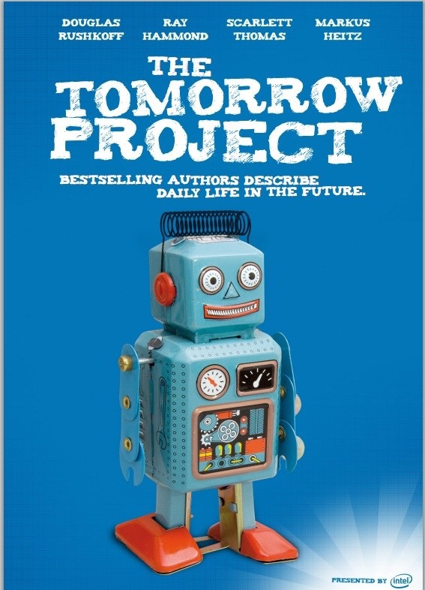
7.2. Robotics meets the Humanities
The Open Roboethics Institute is a web space where policy makers, engineers, designers, users and other stakeholders of the technology can freely share and access roboethics-related contents.

Slide 96
7.2. Roboethics standards
2016-18: IEEE Standards Association opened a draft to public discussion:
2016: The British Standards Institution published the standard “BS 8611: Robots and robotic devices — Guide to the ethical design and application of robots and robotic systems”

Slide 97
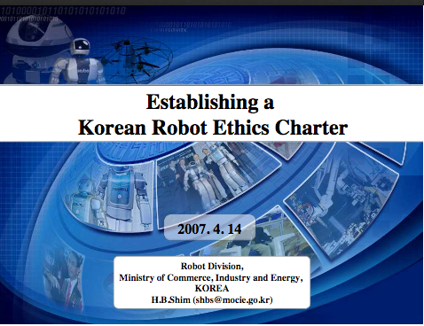
7.2. Roboethics regulations
February 2017: The European Parliament’s Plenary Session adopted the JURI report on
Civil law rules on robotics (2015/2103(INL))
RoboLaw project “Regulating Emerging Robotic Technologies in Europe: Robotics facing Law and Ethics”: deliverable D6.2 - Guidelines on Regulating Robotics (2014)
euRobotics project “The European Robotics Coordination Action”: deliverable D3.2.1- Ethical Legal and Societal issues in Robotics (2012)
2012: South Korea report by their Robot Ethics Charter has three parts devoted to regulations for manufacturers, owners/users, and robots

Slide 98
7.3. Roboethics Initiatives based on Science Fiction
The current acceleration of technological development makes it difficult to scientifically predict how our increasing interaction with robots will affect the evolution of society, the economy, and the life of people in a few years time.
«What SF stories can do better than almost anything else is to provide not just an idea for some specific technical innovation, but also to supply a coherent picture of that innovation being integrated into a society, into an economy, and into people’s lives.»
Change is the dominant factor in society and «our statesmen, our businessmen, our everymen must take on a science fictional way of thinking.»
Several initiatives have recurred to science fiction to explore possible benefits and risks of some technological innovations.
[Torras 2016]
[Stephenson 2011]
[Asimov 1998]
[Torras 2015]

Slide 99
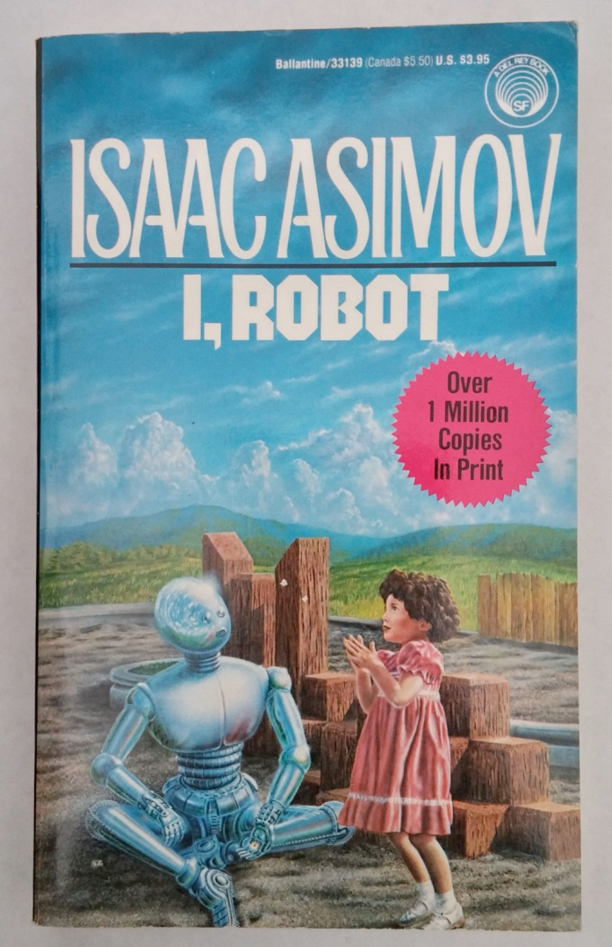
7.3. Roboethics Initiatives based on Science Fiction
When trying to establish an ethical debate, disseminate concepts to the general public, or teach a course on roboethics, classic science fiction stories are often used to exemplify possible future conflicting situations.
Robot nannies Humanoid replicas Emotional surrogates

Slide 100
7.3. Roboethics Initiatives based on Science Fiction
Asimov’s three laws of robotics, simplistic and generally impractical as they may be, have proven provocative and useful to trigger ethical research.
Concerns about robot nannies (discussed in Section 4) already appeared in classical science fiction stories:
I. Asimov (1950) “Robbie” (protection vs. freedom)
Ph.K. Dick (1955) “Nanny” (lack of privacy, risk of deceit)
R. Bradbury (1969) “I sing the body electric” (empathy and autonomy deficit)
E.T.A. Hoffmann (1816) “The Sandman” (love attachment to artificial creatures)
M. Shelley (1818) “Frankenstein” (problems with creating a human-like being)
K. Capek (1920) “R.U.R. Rossum’s Universal Robots” (anthropomorphism, impact on employment, human-robot interaction, social responsibility)
[Anderson 2008; Murphy and Woods 2009]
[Torras 2010]
[Christoforou and Müller 2016]

Slide 101
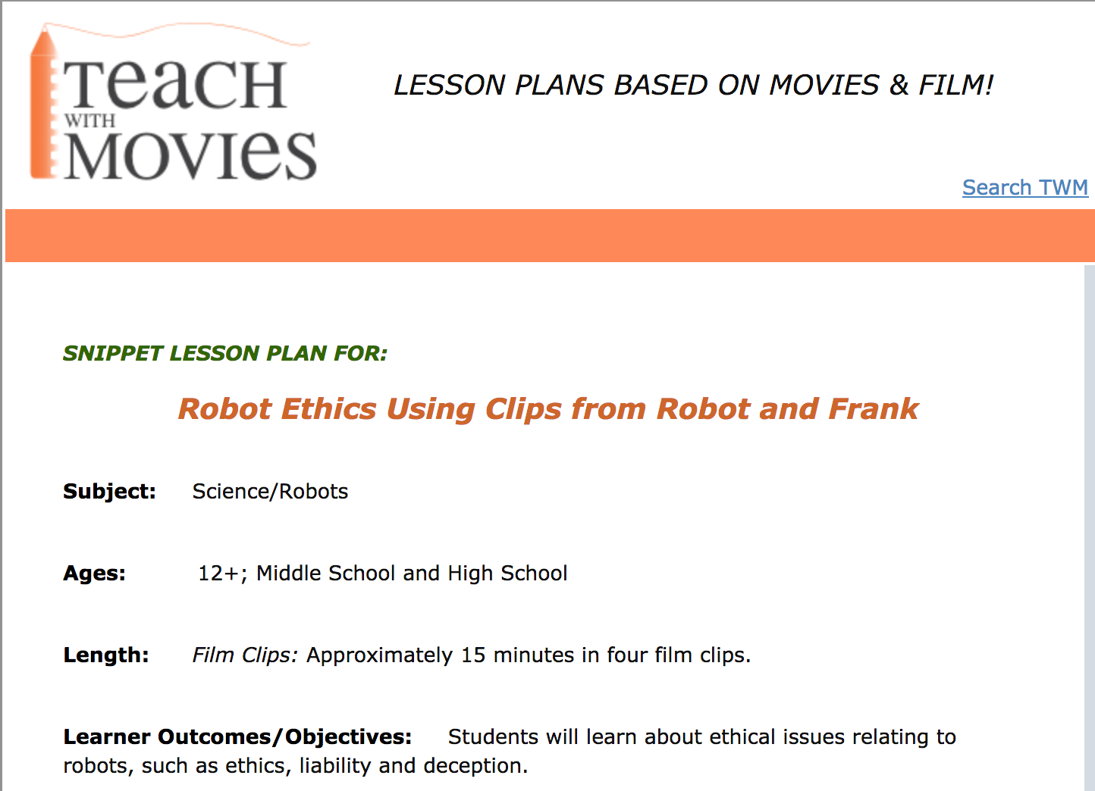
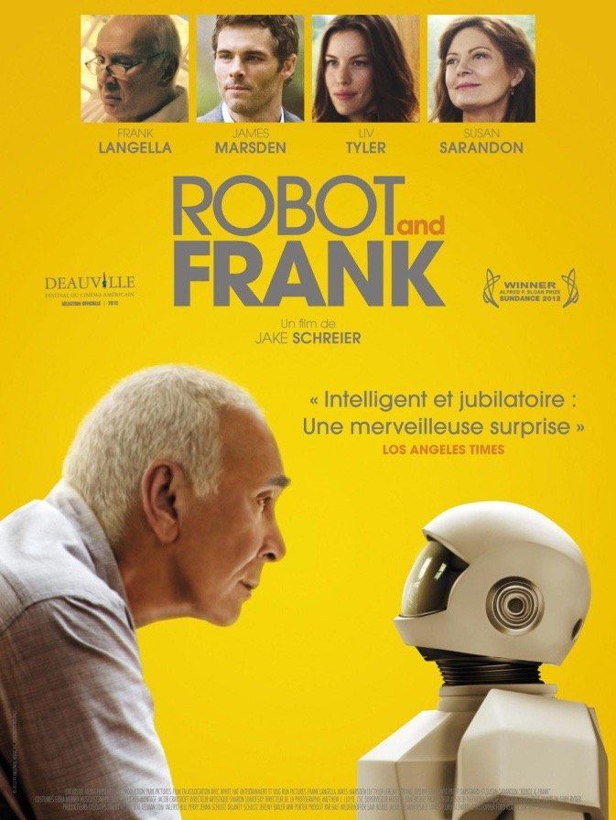
7.3. Roboethics Initiatives based on Science Fiction
Some online courses rely on recent science fiction movies

Slide 102
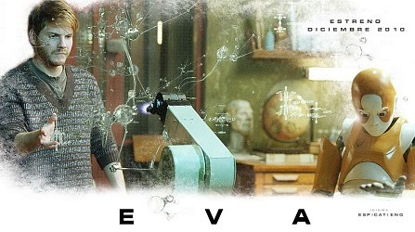
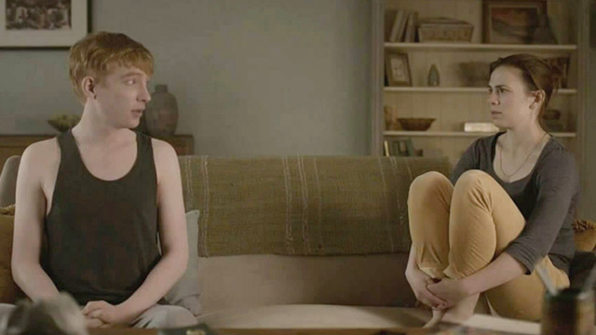
7.3. Modern Science Fiction related to Roboethics

Slide 103
7.3. Science Fiction studies related to Roboethics
Studying the roles played by robots in movies from a historical perspective —with special attention to their degree of autonomy—helps to predict how humans may or may not accept robot integration into society.
The results of a survey about how people perceive robots in thirty popular sci-fi movies and who they feel is responsible for their actions—the robot itself, the designer/manufacturer, the programmer or the user—permits analyzing ethical issues related to human-robot interaction.
[Iverach-Brereton 2011]
[El Mesbahi 2015]

Slide 104
Amazing future perspectives
What role should the human being and the robot play in this pas de deux in which we are irrevocably engaged?

